Slide 1

An Update on Exudate
Wound Solutions Australia
July 2019
Fleur Trezise RN NP
Wound Management
Director – Wound Solutions Australia

Slide 2


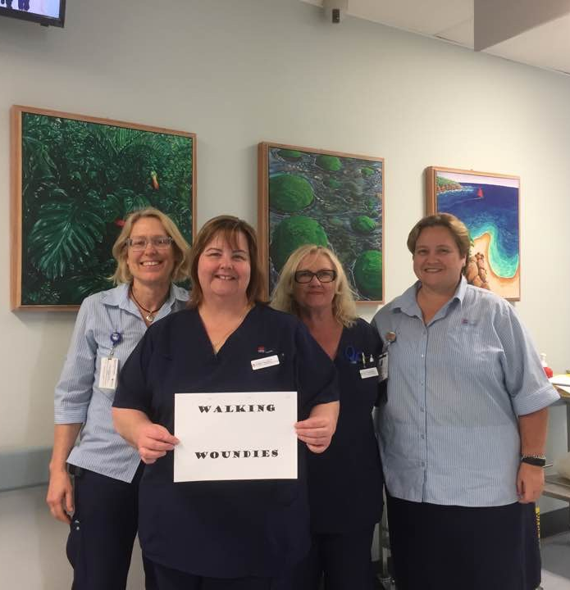
Who am I

Slide 3
Session objectives
Examine the role of wound exudate in wound healing
Explore ways to effectively assess and manage wound exudate
Examine the role of dressings in the management of wound exudate
Clinical challenges

Slide 4

World Union of Wound Healing Societies (WUWHS) Consensus Document.
Wound exudate: effective assessment and management . Wounds International 2019
Notes:
Much of todays session has been drawn from this Consensus document which was developed by the World Union of Wound Healing Societies. It is their second consensus document focusing on wound exudate, the first being published in 2007.
With the recognition for the need for more up-to-date guidance this document was produced to provide clear, practical guidance to help clinicians effectively assess and manage exudate to prevent exudate related complications and improve outcomes for patients

Slide 5

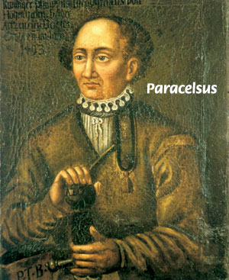
Described wound exudate as
“natures balsalm”
Notes:
Sometime in the 1500’s

Slide 6
Wound exudate
Plays a key role in wound healing and is produced as a normal and essential part of the healing process
Can delay healing when the amount is wrong, the place is wrong, and the composition is wrong
We need to be able to effectively assess and manage wound exudate to facilitate timely healing of wounds

Slide 7
What is wound exudate?
Exuded matter; especially the material composed of serum, fibrin, and white blood cells that escapes into a superficial lesion or area of inflammation.
The fluid produced by a wound as it heals, and is a normal part of the healing process
Notes:
Wound exudate is derived from blood so it contains a wide variety of things such as water, fibrin, glucose, immune cells, platelets, proteins, growth factors, proteases, metabolic waste products, micro-organisms, wound debris and dead cells (slough)

Slide 8
Importance of wound exudate
Provision of a moist wound environment
Diffusion of immune mediators & growth factors across the wound bed
Medium for migration of tissue-repairing cells across wound bed
Supplying essential nutrients needed for cell metabolism
Promoting the separation of dead or damaged tissue (autolysis)
Notes:
In wounds that are healing without complications through the standard stages of wound healing – exudate supports the healing process by:

Slide 9
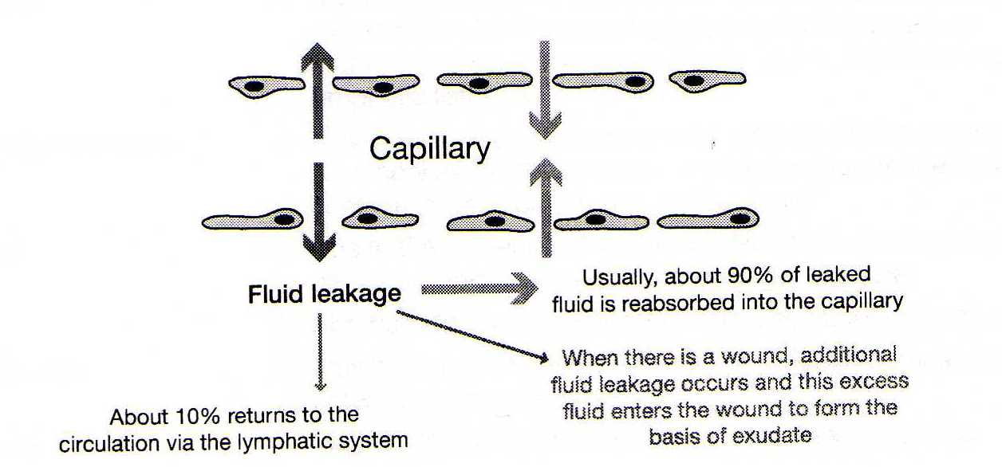
Formation of wound exudate
WRONG
RESPONSE TO WOUNDING
(Starling 1986, Ganong, 2005)
Notes:
An understanding of the processes underlying wound exudate production enables us to consider all likely causes and to plan appropriate interventions when exudate interferes with wound healing
To prevent fluid accumulation in the tissues and to maintain homeostasis there needs to be a mechanism for the drainage and recirculation of interstitial fluid.
When there is a wound, the excess fluid enters the wound where it forms the basis of exudate.
Up until recently it was thought that around 90% of leaked fluid was reabsorbed into the capillaries and the rest via the lymphatic system. WRONG

Slide 10
Recent Evidence -
Lymphatic system more prominent role in maintaining fluid circulation
In normal circumstances – no reabsorption into capillaries (Mortimer & Rockson, 2014)
The interstitial fluid (approx. 8 litres/day is taken up by the lymphatic system – becomes lymph and then eventually returned to the central circulatory system (Levic & Michel, 2010; Mortimer & Rockson, 2014)
www.wikipedia.com

Slide 11
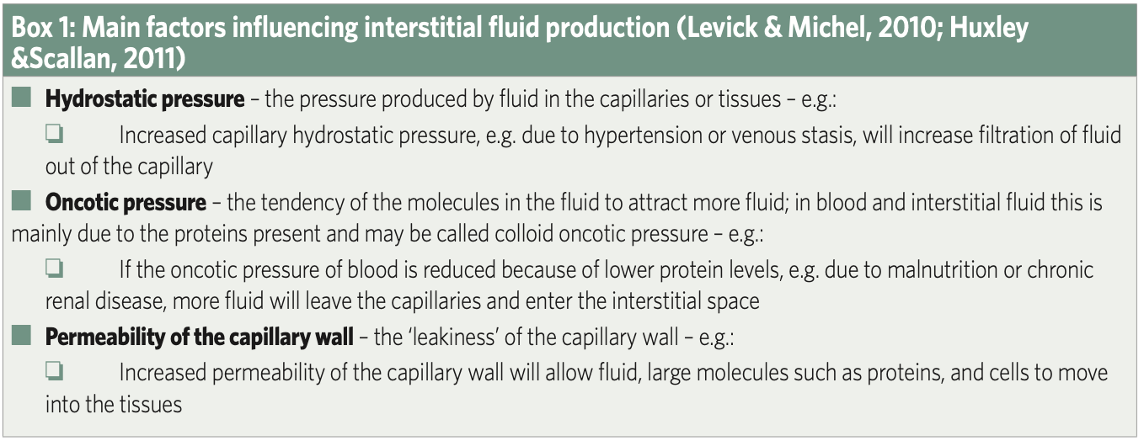
Why is this important?
Any factor that increases the amount of interstitial fluid held in the wound tissues will increase exudate amount at the wound surface
WUWHS 2019
Notes:
If the rate of interstitial fluid production exceeds the drainage capacity of the lymphatic system – tissue oedema results so if a wound is present, the amount of fluid draining from the wound will increase.
Increased capillary permeability can be caused by pro-inflammatory mediators such as histamine and bradykinin. It can also be caused by damage to the structural integrity of the capillaries, so if you have a wound, these processes will be occurring, and will increase interstitial fluid production and wound exudate.

Slide 12
Biochemical differences in wound exudate – healing & non-healing wounds
Exudate component | Level in non-healing wounds compared to healing wounds
Pro inflammatory cytokines | Higher
Matrix Metalloproteases (MMP2 and MMP9) | 10-25 times higher
Growth Factors | Lower
Mitogenic Activity | Lower

Slide 13
Why is this important?
Pro-inflammatory cytokines – these are cell-signaling molecules that stimulate inflammatory process and increase levels of MMP’s
Matrix metalloproteases MMP2 & MMP9 – High levels can result in growth factor degradation, decreased cell proliferation and migration and disruption of new ECM
Growth Factors – these stimulate proliferation & migration of cells involved in angiogenesis, epithelialisation, contraction, and ECM deposition
Mitogenic Activity – the ability to stimulate fibroblast proliferation is decreased in the presence of chronic wound fluid
Notes:
In the wound healing process, controlled inflammation is necessary and beneficial It when things go wrong that it all becomes problematic
MMPs are essential for wound healing and have a role in all phases including debridement, angiogenesis, contraction , epithelial migration and remodeling. But they must be in the right place at the right time in the right amount

Slide 14
In Balance – Healing Wounds
Water
Waste
Nutrients
Electo-lytes
G
factors
MMP’s
WBC
Inflamm mediators
Cytokines
Notes:
Stimulates cell proliferation
Breaks down ECM to allow healing

Slide 15
Healthy Wound Fluid -
Assists Healing
Aids
autolysis
Aids migration
tissue
repairing cells
growth &
immune
factors
Nutrients for
cell
metabolism
Wound bed stays moist

Slide 16
Out of Balance - non-healing wounds
Water
Waste
Nutrie-nts
Electo-lytes
G
factors
MMP’s
WBC
Inflamm mediators
Cytokines
Notes:
Elevated levels of MMP’s
Increased inflammatory mediators – prolonging inflammation

Slide 17
Non-healing wound exudate - Adverse Wound Healing
Slows down
proliferation
Interferes with
availability
of
growth
factors
Contains proteases -
damage the ECM.
Elevated levels
inflammatory
mediators
Protein loss,
skin damage, oedema,
medium for bacteria
Notes:
Elevated levels of matrix metalloproteinases
Inflammatory cytokines
Decreased growth factor activity
Low levels of cell mitosis
Senescent cells

Slide 18
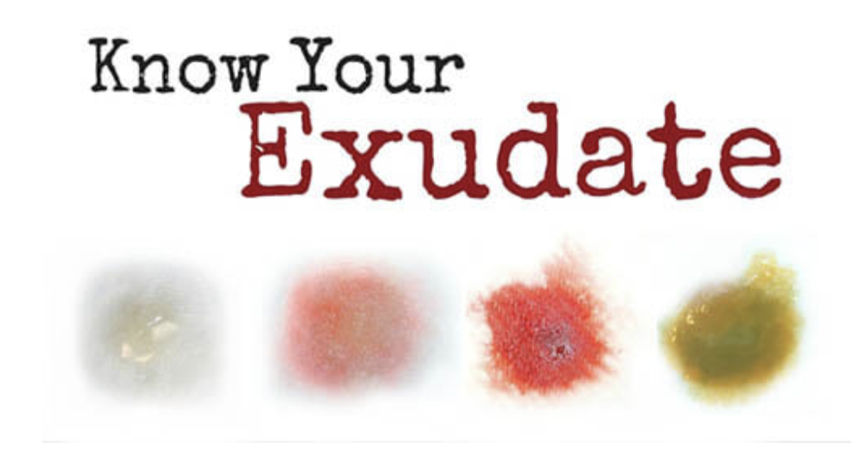
Wound Care Education Institute

Slide 19
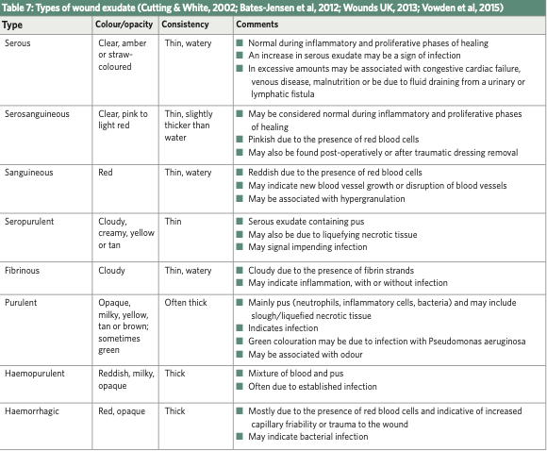
WUWHS 2019

Slide 20
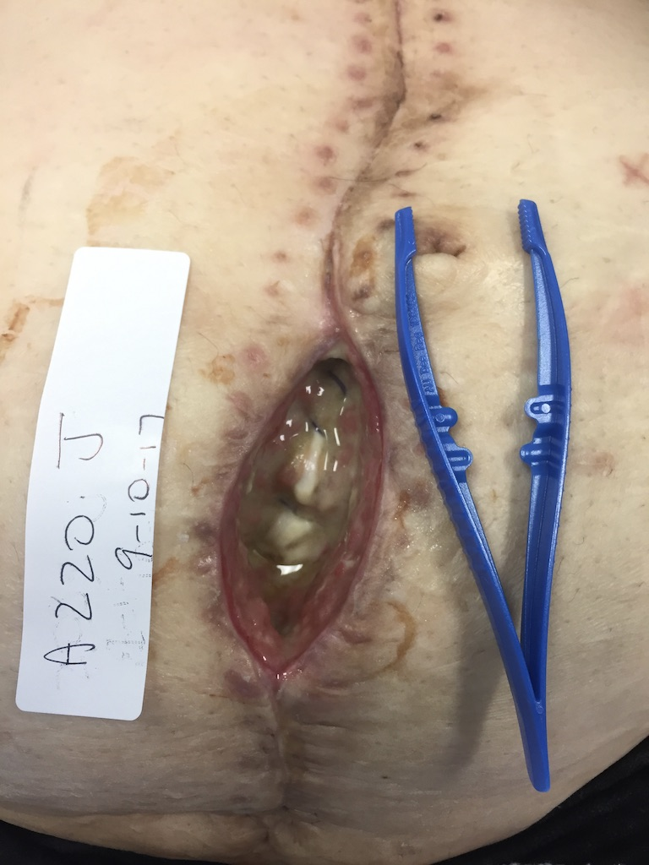
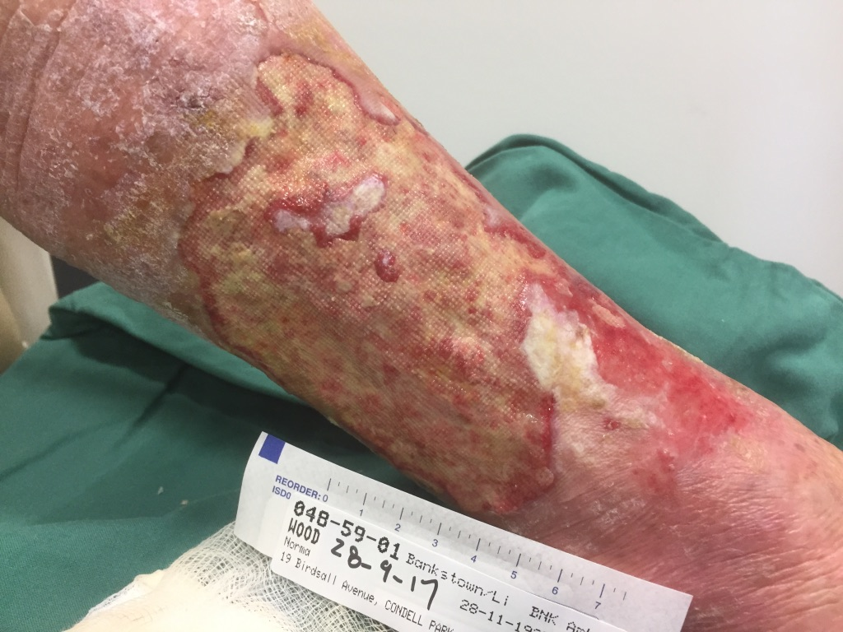
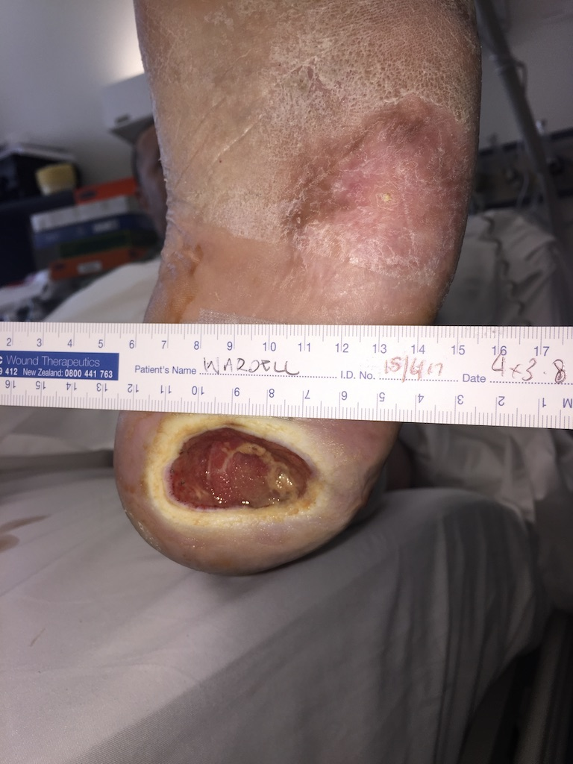
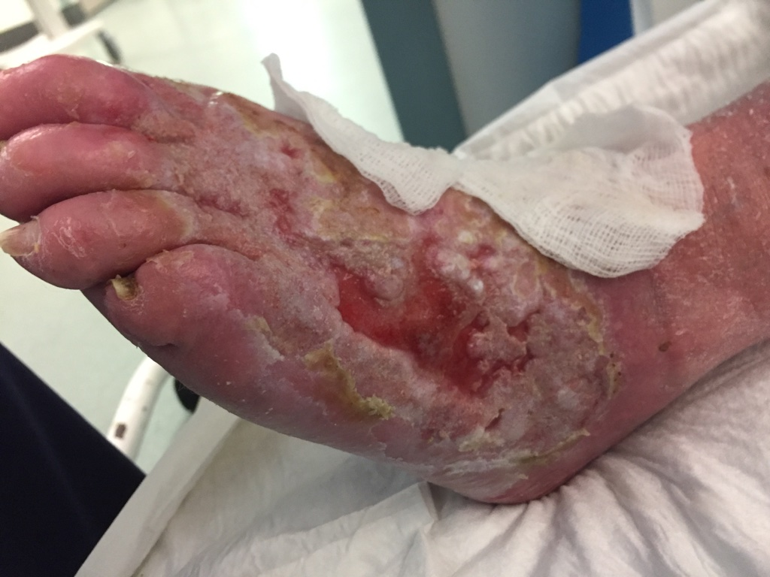
All images used with patient consent
Notes:
And clinically we can all identify with this.
When there is and increase in exudate volume we see the maceration around the edges of the wound, we see the excoriation caused by caustic chronic wound fluid with its higher levels of inflammatory molecules stimulating the production of proteases that degrade protein, damage the extracellular matrix, degrades growth factors and hinders cell proliferation.
Having an understanding of this can help us choose appropriate therapeutic interventions aimed at stimulating healing.

Slide 21
Normal & Abnormal drainage from a surgical wound
NORMAL
Clear or slightly yellow, or tinged with pink
Small amount - thin and watery
No odour
Very small amount bleeding
Swelling, redness, tenderness diminishes with time
ABNORMAL
Contains large amount blood
Contains pus and is yellow, grey, green
or brown
Foul odour
Wound becomes increasingly red,
tender and swollen

Slide 22
Effects of excessive exudate production
Leakage and soiling
Malodour
Increased infection risk
Increased frequency of dressing changes
Discomfort and pain
Protein loss – fluid and electrolyte imbalance
Peri-wound skin damage (MASD)
Increase in wound size
Psychosocial effects

Slide 23
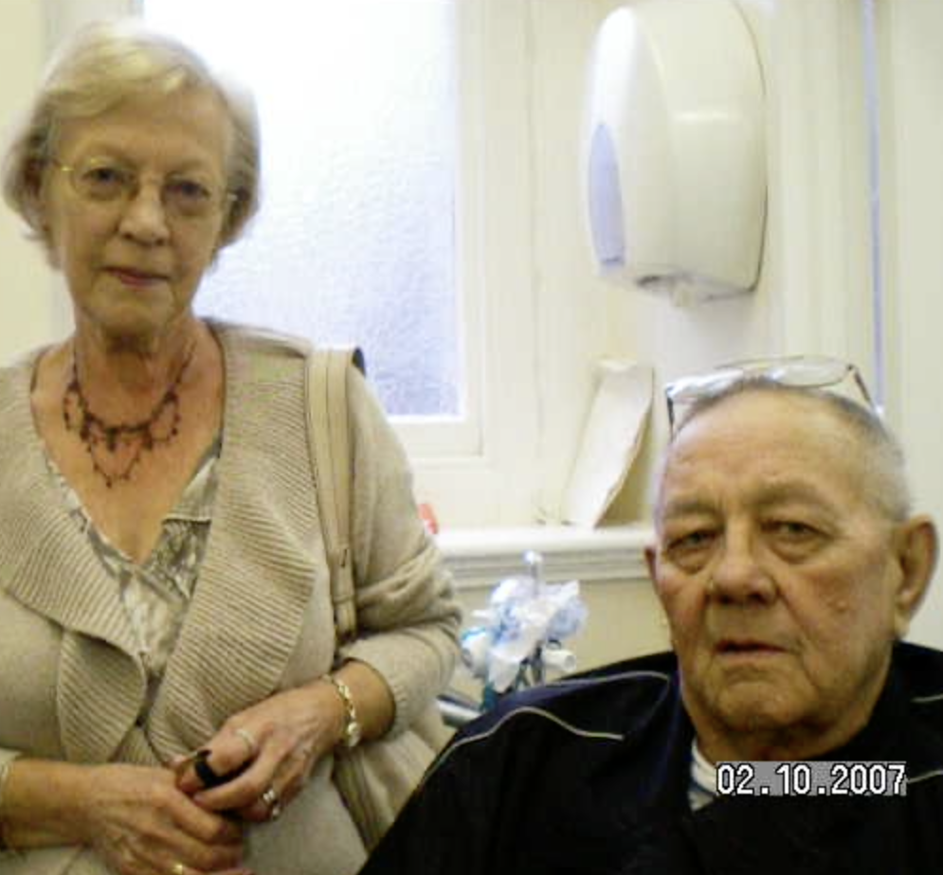
People’s experience of living with chronic heavily exuding wounds
Embarrassment
Emotional distress
Leakage
Odour
Sleep disturbance
Discomfort
Financial Distress
Pain
Social isolation
Notes:
distress

Slide 25
Assessing & Dressing

Slide 26
Aim of exudate management
Optimise the wound bed moisture level appropriate for the patient
Protect the surrounding skin
Prevent and treat exudate related problems
Manage symptoms
Improve quality of life
Notes:
We need to remember that this is not just about appropriate dressing selection to manage the moisture, but includes biofilm based wound care, wound debridement, oedema management, compression therapy and infection management

Slide 27
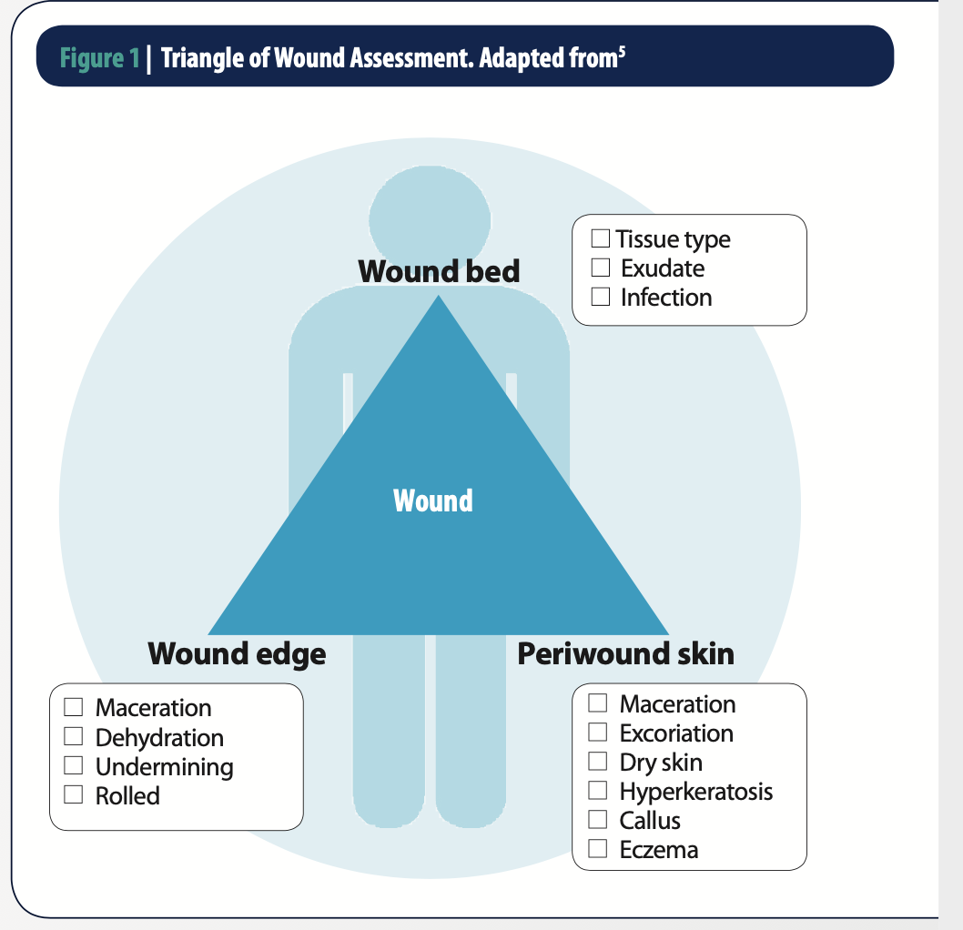

Slide 28
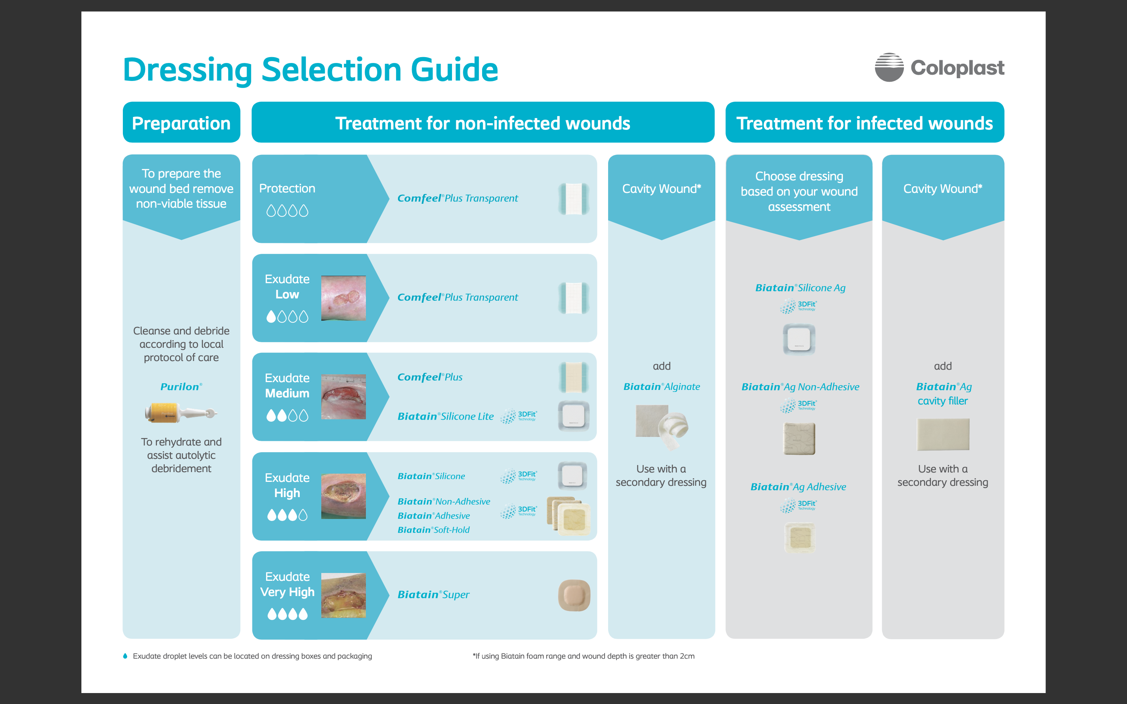

Slide 29
Assessing Wound Exudate – part of your holistic assessment
A change in exudate can indicate a change in
wound status or disease processes re-evaluate
ASSESS & DOCUMENT
Colour
Consistency
Odour
Volume
Effectiveness of current treatment regime
Notes:
In a healing wound, exudate appears to promote healing. In the non-healing or chronic wound exudate appears to have a detrimental effect and to have a different composition.

Slide 30
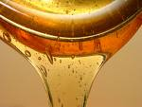
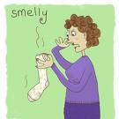
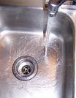
Colour, Consistency, Odour, Volume
Notes:
Examining the colour, consistency and odour of wound exudate will provide us with information as to the state of the wound.
For example, green exudate may be related to a wound infection and exudate with high viscosity may indicate the presence of necrotic material or inflammation whilst thin, runny exudate may be indicative of a low protein content due to malnutrition or congestive cardiac disease.
We all know an unpleasant odour is most commonly associated with bacterial growth, necrotic tissue or perhaps an enteric fistula.
It is also important to remember that some dressings such as the hydrocolloids may produce a particular odour.

Slide 31
Volume – the Goldilocks Principle
Not too Dry
Not too Wet
BUT JUST RIGHT

Slide 32
Describing Exudate amounts
SMALL
MOD
HEAVY
NIL
LEAKING
SATURATED
WET
MOIST
Exudate Score | Extent of Control | Exudate Amount | Dressing Needs
1 | Full | None/minimal | No absorptive dressing
2 | Partial | Moderate | Dressing changes every 2-3 days
3 | Uncontrolled | High/very high | Absorptive dressing at least daily
DRY
Notes:
We are still waiting for a widely accepted wound exudate level assessment tool. In the meantime, we should be consistent in the way we assess exudate so we are all on the same page.

Slide 33
DRY
Primary dressing is
UNMARKED
Wound bed dry

Slide 34

MOIST
Primary dressing is
lightly marked
Small amount fluid visible on wound bed

Slide 35
WET
Primary dressing is
Extensively marked
Small amount fluid visible on wound bed

Slide 36
SATURATED
Primary dressing is
WET with
strikethrough

Slide 37
LEAKING
Dressing is SATURATED
Leaking onto clothes and beyond.

Slide 38

Assessing the Current Dressing
Don’t let the dressing be discarded without seeing it.
How can we assess or plan future management without this review?

Slide 39
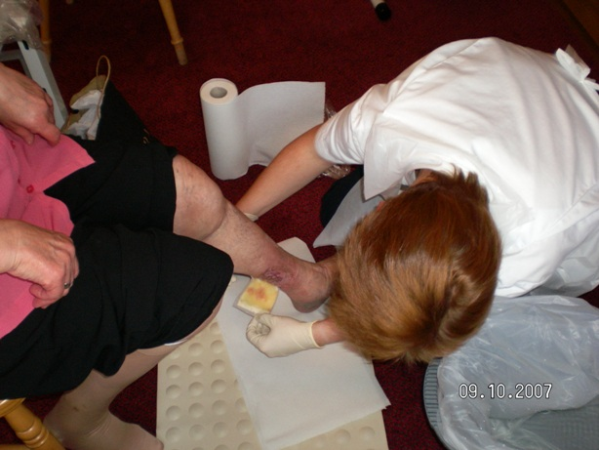

Slide 40

Before you Remove
What method of attachment is used and was it suitable?
  Tape
  Crepe bandage
  Retention stocking
  Compression bandage
  None
What is the interaction between the dressing & exudate?
  How wet is the wound?
  Exudate type
  Is the dressing coping?

Slide 41
Dressing removal checklist
ASSESSMENT | YES/NO
Lifting Rolling Dislodged Scrunched up?
Saturated/Leaking/Strikethrough? Malodourus
Pain on removal Dressing adhered to wound bed?
Wound bleeds when dressing removed?
Skin damaged when dressing removed Damaged peri-wound area – eg maceration
Dressing change required BEFORE planned date?

Slide 42
Choosing the right dressing – mode of action
Absorption
Evaporation/transmission
Fluid retention
Sequestration of exudate components
WUWHS 2006
Notes:
Absorption is where fluid enters the dressing materials by diffssion and you will often hear terms such as capillary action or vertical or lateral wicking. Simple absorptive dressings hold the fluid in spaces within their structure similar to a sponge. There is the potential for leakage if these dressings are placed under pressure.
Evaporation or transmission is where moisture is allowed to evaporate from the surface of the dressing. This is known as the moisture vapour transmission rate or MVTR.
Fluid Retention dressings include the hydrocolloids such as Duoderm or Comfeel, the Calcium alginates such as Kaltostat or Curasorb and the carboxymethylcellulose (CMC) fibre dressings such as Aquacel. They all take up liquid and form a gel and when place under pressure the gel changes shape but retains the fluid.
Sequestration of exudate components is where bacteria and enzymes are trapped within the dressing in a process coined sequestration. To date\, this has only been shown in invitro studies

Slide 43

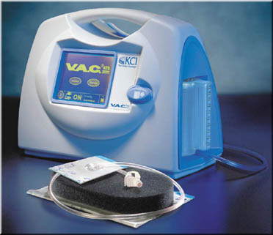

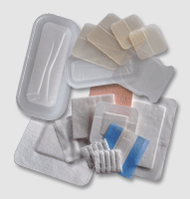
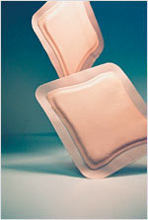
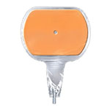
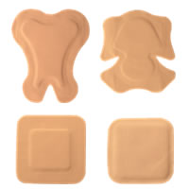
Notes:
There are a plethora of wound care products on the market being promoted as exudate management dressings and just deciding on the most appropriate dressing for your patient can be a challenge. We have all seen cases where “bluey’s” and incontinence pads have been used to mop up excessive wound exudate and those times when correcting that moisture imbalance seems like an impossible task.

Slide 44
Dressing Materials – fluid handling
Dressing material | Indicated Usage
 | Fluid donation | Light control | Medium | High
Wound contact layers |  | 
Fibre or fabrics |  |  |  | 
Films |  | 
Hydrogels |  | 
Foams |  |  |  | 
Hydrocolloids |  |  | 
Alginates |  |  |  | 
CMC’s hydrofibres |  |  |  | 
Super absorbent polymers (SAP) |  |  |  | 

Slide 45
Know when to adapt your management
Difficulty containing exudate
Managing infection/biofilm
Protecting peri wound skin
Consider Patient Referral
WUWHS 2019

Slide 46
Challenges
Recognise when exudate becomes problematic.
Know when wound healing is delayed as a result
Notes:
Remember that....Chronic wound fluid
Breaks down extracellular matrix, proteins and growth factors.
Prolongs inflammation.
Inhibits cell proliferation.
Degrades the tissue matrix
...

Slide 47
Remember
Wound exudate NOT JUST AN INERT FLUID
MANAGE it to minimise detrimental effects and maximise positive effects
Observe for changes in exudate. Why has it changed?
Modify treatment as required

Slide 48
Remember
Interaction between exudate and dressing influences local management.
Review the dressings you are removing
Know the manufacturer’s instructions
The decisions we make affect more than the wound
Exudate – understand it, assess it, manage it.

Slide 49
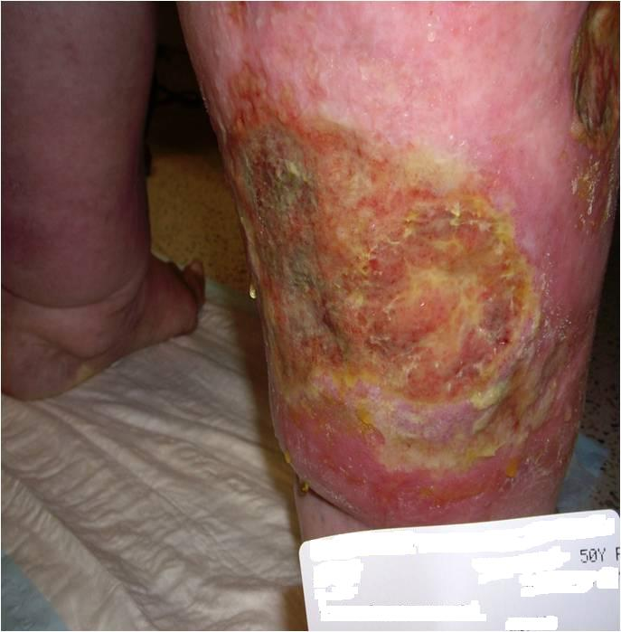
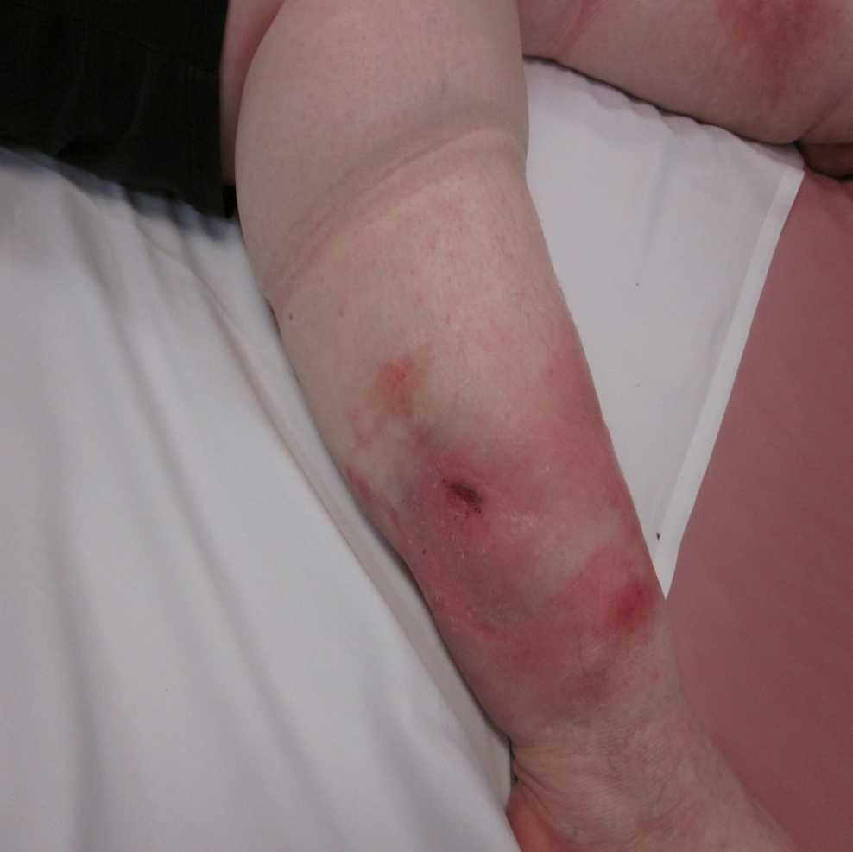
Clinical Challenges

Slide 50
Clinical Challenge
www.coloplast.us

Slide 51
Wound Exudate
Just one piece of the
bigger picture
Thank you

Slide 52
References
World Union of Wound Healing Societies Consensus Document. Wound exudate effective assessment and management. Wounds International 2019
Dowsett C (2012) Management of wound exudate. Independent Nurse.
Tickle J. (2013) Living Dy-To-Day with a heavily exuding wound: Recommendations for Practice. Wound Essentials Vol 8 No 1

